Slide 1




LDPC Codes for 5G NR
Lab Group: 3
Project Group: 3
Assigned by : Professor Yash Vasavada
TA-Mentor : Vansh Joshi

Slide 2


Honor Code
The work we are presenting is our own work and we have not copied the work (Matlab code, results, etc) that someone else has done.
Concepts, understanding and insights we will be describing are our own.
Wherever we have relied on an existing work that is not our own, we have provided a proper reference citation. We make this pledge truthfully, knowing that violation of this solemn pledge can carry grave consequences.

Slide 3



Table of contents
01
02
03
Introduction
Base Graphs
Encoding
04
05
06
Modulation and AWGN
Decoding
Final Results

Slide 4




01
Introduction

Slide 5


What is LDPC ?
LDPC (Low-Density Parity-Check) codes are Linear block error-correcting codes used in digital communications.
They were first introduced by Robert G. Gallager in the early 1960s but gained significant attention in the late 1990s due to their excellent performance in practice.
LDPC codes are characterized by sparse parity-check matrices, meaning that most of the elements in the matrix are zeros.

Slide 6
LDPC codes in 5G NR(New Radio)
LDPC codes are employed in 5G NR for robust error correction.
Used primarily for data channel coding, LDPC codes offer flexible code rates.
5G NR specifies protograph-based LDPC codes, ensuring efficient encoding and decoding.
These codes feature short to moderate block lengths, balancing latency and throughput.
Efficient decoding algorithms like belief propagation are employed for reliable data recovery.
LDPC codes in 5G NR deliver high coding gain and spectral efficiency, enhancing network performance.

Slide 7
Block Diagram
Transmitter
Encoder
Modulator
Information Source
+
AWGN
Decoder
Demodulator
Information Sink
Receiver

Slide 8
02
Base Graph

Slide 9



Basics of Base Graph
In 3GPP standard, different type of Representation of Parity Check Matrix which is called base graphs is used.
There are 2 types of base graphs in 5G standard : BG1(46 x 68), BG2(42 x 52)
These base graphs can have entries from -1 to Zc-1, where Zc is called expansion factor.
.
For BG1, K =22Zc
For BG2, K =10Zc
Where K is the maximum number of information bits.
It is possible to reuse a single base matrix to support different code rates and codeword sizes.

Slide 10
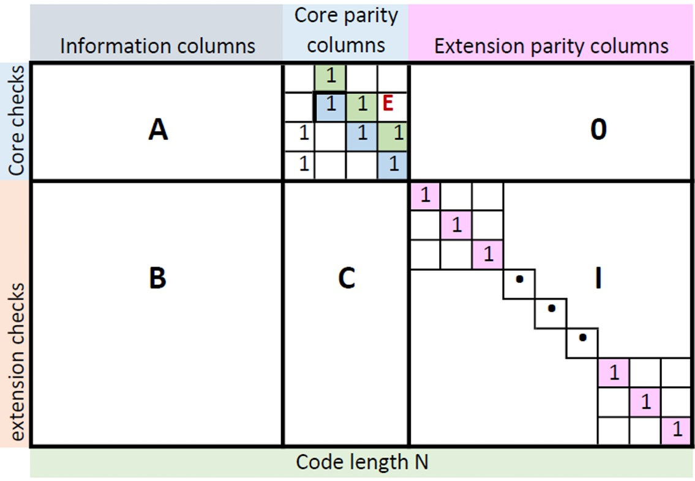
Base Graph structure
[2]

Slide 11
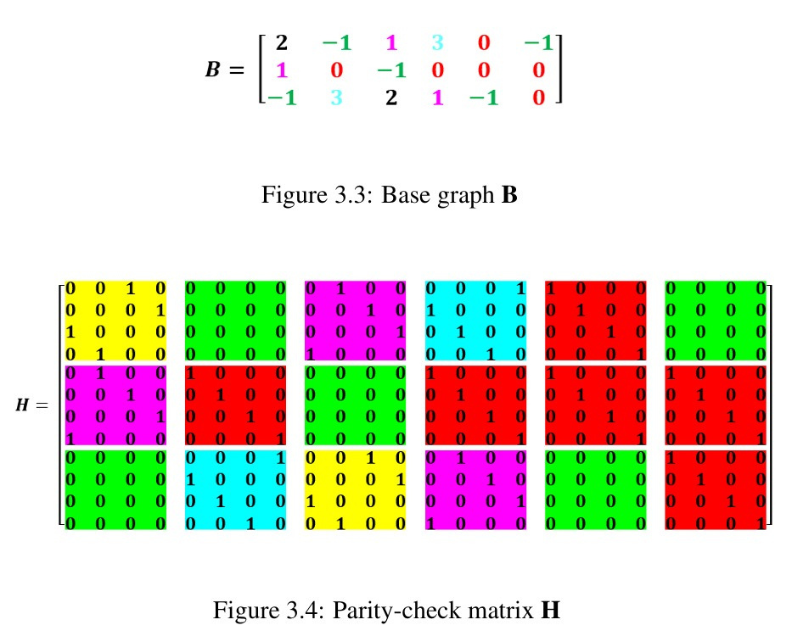
Base Graph to Parity Check Matrix
Here,
-1 is replaced by Z x Z all 0 matrix
0 is replaced by Z x Z Identity matrix
X is replaced by Z x Z sized identity matrix with circularly right by that X number, where 0 < X < Zc-1
In this example Z = 4
[2]

Slide 12
03
Encoding

Slide 13

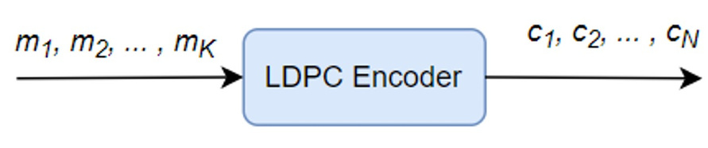


m : message vector (k x 1)
p : parity vector ((n-k) x 1)
c : codeword vector (n x 1)
here c = m
p
For encoding, we use Base matrix.
Hc = 0 (where H is punctured Parity-check Matrix)
where 0 is (n-k) x 1 all zero vector.
Code rate (r) = k/n
[]
For encoding, we need to find parity bits.
we used the double diagonal structure of the base graph which is the representation of H matrix to find parity bits and codeword.
[2]

Slide 14
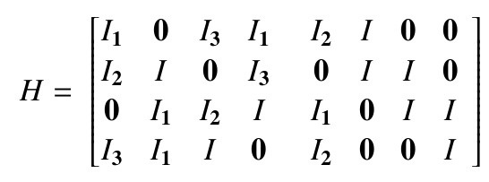
Computation of Parity bits
To understand the procedure to compute parity bits, given example is used.
let, m’ = [m1 m2 m3 m4],
p’ = [p1 p2 p3 p4]
so, c’ =[m1 m2 m3 m4 p1 p2 p3 p4]
here, Hc = 0 give us 4 equations. By using those equations we can find parity bits.
[2]

Slide 15
Use of Double-Diagonal Structure to compute parity bits
I1m1 + + I3m3 + I1m4 + I2p1 + Ip2 = 0 ----(1)
I2m1 + Im2 + I3m4 + Ip2 + Ip3 = 0 ----(2)
I1m2 + I2m3 + Im4 + I1p1 + Ip3 + Ip4 = 0 ----(3)
I3m1 + I1m2 + Im3 + I2p1 + Ip4 = 0 ----(4)
Add equations (1), (2), (3) and (4),
I1p1 = I1m1 + I3m3 + I1m4 + I2m1 + Im2 + I3m4 + I1m2 + I2m3
+Im4 + I3m1 + I1m2 + Im3
Using this equation, we can find p1 and then using above equations, we can also find p2,p3,p4.
[2]

Slide 16
This technique can be used in 5G NR base graph.
For the first 4 rows, double-diagonal structure can be used to calculate p1, p2, p3, p4. Then pi can be calculated in row i, where i > 4 .
After parity bits were calculated, codeword bits can be obtained. The first two message blocks in the base graph are not transmitted in 5G NR. They are always punctured to improve performance.

Slide 17
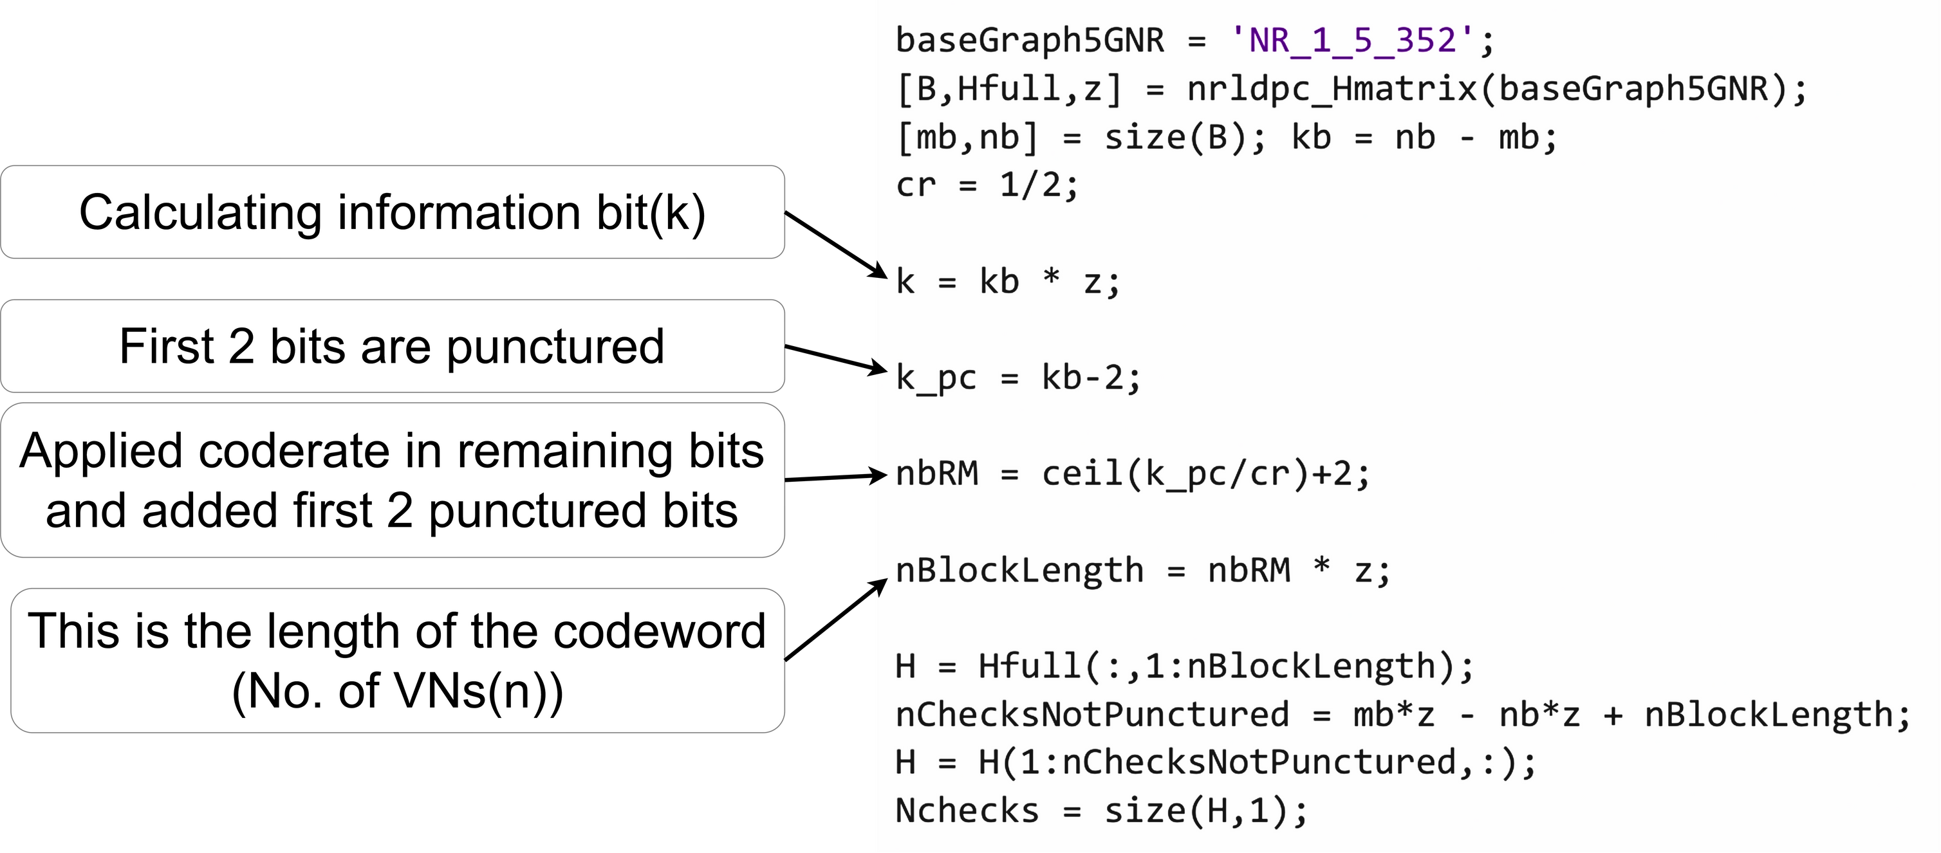
Code-Rate matching:
Here we have taken example of NR_1_5_352 and coderate 1/2
No. of CNs(u) = Length of codeword(n) - No. information bits(k)
Punctured top left part of Hfull sized uxn

Slide 18
04
Modulation & AWGN

Slide 19


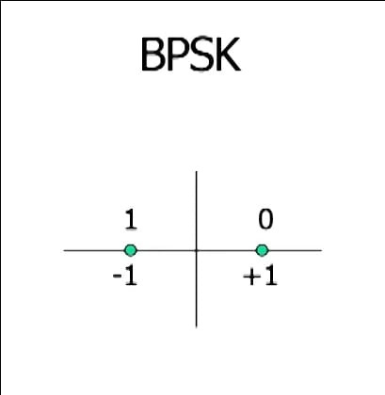

Modulation
Binary Phase Shift Keying maps bits to symbols by representing symbols as phase shifts in the carrier signal.
It's efficient and useful in noisy environments, making it a good choice for communication channels prone to interference.
Equation: S = 1 - 2b
[1]

Slide 20
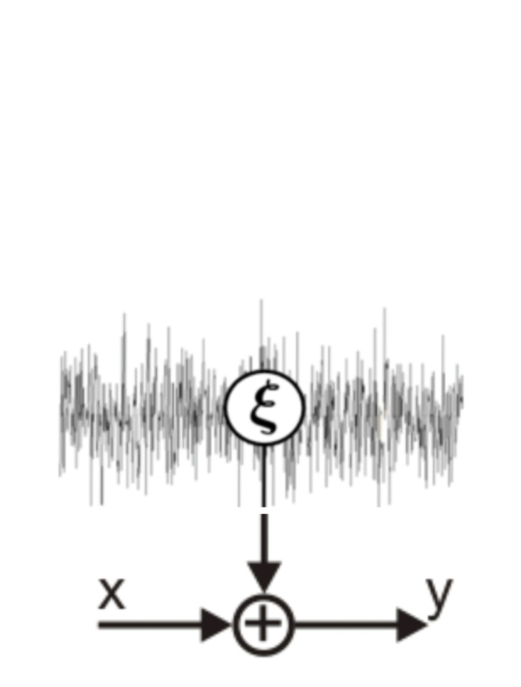
AWGN
The noise is added to the signal during transmission or processing. In communication systems, the transmitted signal gets mixed with noise as it travels through the channel, affecting its quality.
The channel adds a noise signal that is independent and Gaussian distributed.
Variance of Noise = 1/(2*EbNo*r) , r = code rate

Slide 21
05
Decoding

Slide 22
IMPLEMENTATION OF THE DECODER
We started by taking a part of the H matrix and made two lists: one showing all VN connected with their CN and vice versa. Then, we tested different signal-to-noise ratios (Eb/No) from 0 to 10, increasing by 0.5 each time.
For each ratio, we ran a simulation 1000 times. In each simulation, we created a random message of the valid length, encoded it, sent it through BPSK modulation, and added AWGN noise. The receiver then got this noisy message and decoded it using both hard and soft decision decoding.
On the following slides, we'll explain how this decoding process works.

Slide 23
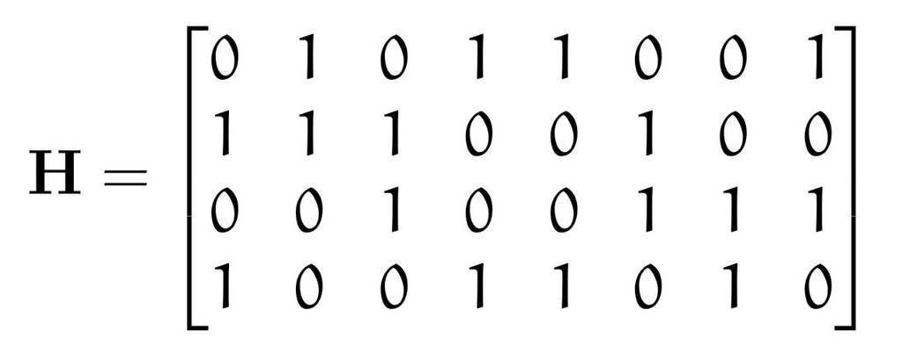
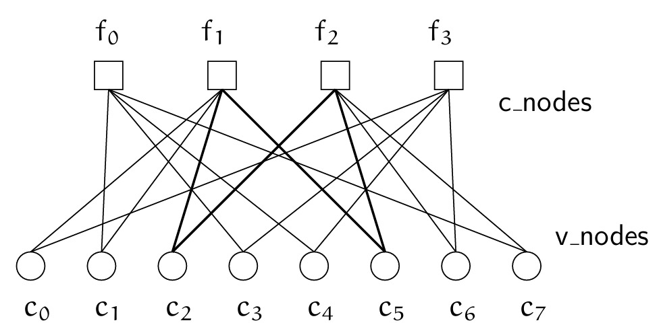
Basics
Parity check matrix
Tanner Graph
[4]

Slide 24
HARD DECISION DECODER
After demodulating the received signal, In hard decision decoding, each variable node (VN) passes its relevant value in bit to the connected check node (CN). The same exchange of information bit happens from the CN to the VN.
The message transfer from VN to CN is done by repetition code and CN to VN is done by SPC code.

Slide 25
In the first iteration:
VN to CN message passing:
CN1
CN2
CN3
CN4
0
0
0
0
VN1
0

Slide 26
CN to VN message passing (SPC):
CN1
1
0
1
VN1
VN2
VN3

Slide 27
VN to CN message passing (Repetition):
CN1
CN2
CN3
CN4
1
0
1
1
VN1
1

Slide 28
CN to VN message passing (SPC):
CN1
1
1
0
VN1
VN2
VN3
And So On...

Slide 29
Computing estimated value:
CN1
CN2
CN3
CN4
1
0
1
1
1
VN1
After VN received all values from
CN it will estimate its value using repitition.
1

Slide 30
SOFT DECISION DECODER
Without demodulating the received signal (taking real values), In soft decision decoding, each variable node (VN) passes its relevant belief to the connected check node (CN). The same exchange of information happens from the CN to the VN.
The message transfer from VN to CN is done by repetition code(Sum) and CN to VN is done by Min algorithm by algorithm mentioned before.

Slide 31
What is Min-Sum Algorithm?
For Row Operation:
Magnitude,
Min1 = minimum absolute value of all nonzero entries in row
Min2 = next higher absolute value
Set magnitude of all values(except minimum) = Min1
Set magnitude of minimum value = Min2
Sign,
Parity = product of signs of entries in row
New sign of an entry = (Old Sign)(Parity)

Slide 32
What is Min-Sum Algorithm?
For Column Operation:
Sumj = rj + sum of all entries in Column j , where rj=received value
New Entry = Sum - (Old entry)
After the every iteration we calculate the estimated value of each VN
Where Ĉi = ri + sum of all entries in Column i , where ri=received value

Slide 33
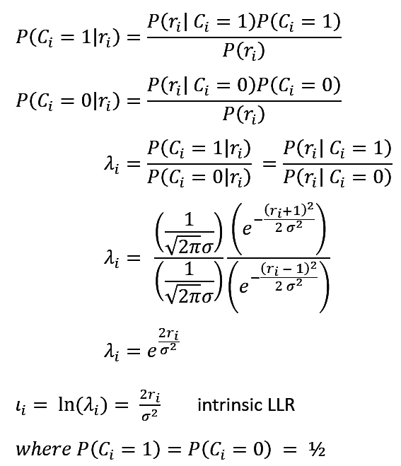
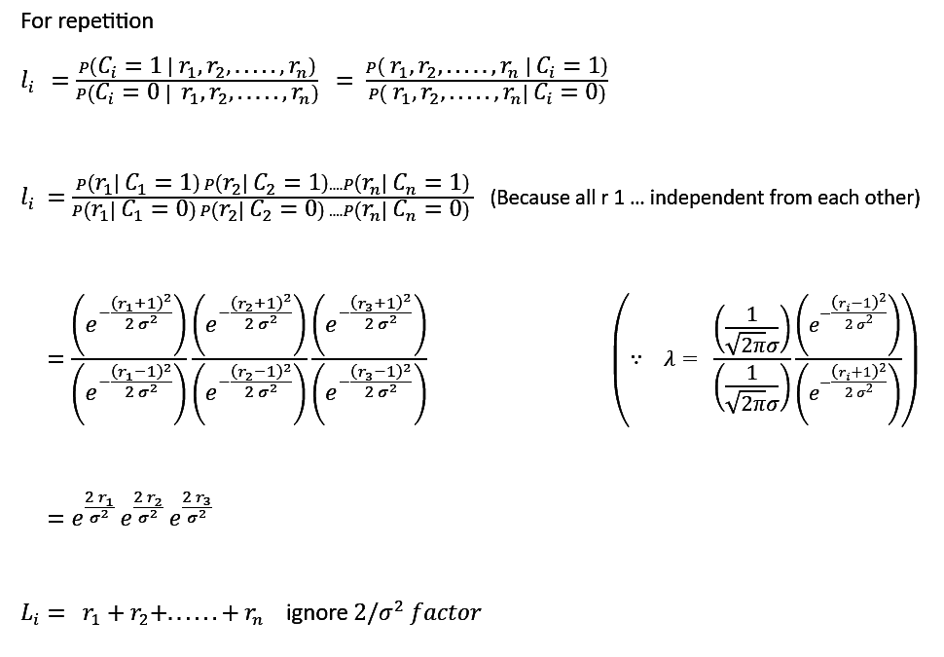
Min-Sum Algorithm
Log likelihood ratio
For (n) Repetition

Slide 34
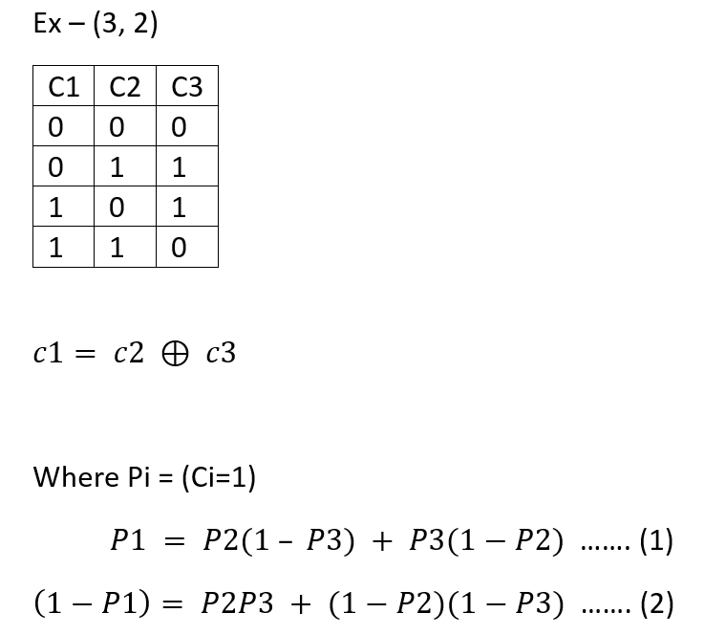
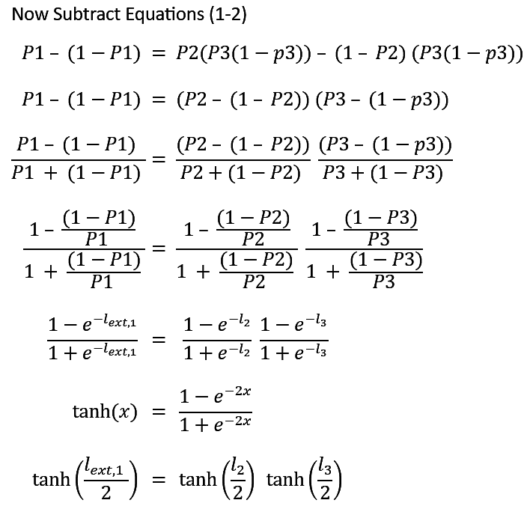
Min-Sum Algorithm
(n, n-1) SPC

Slide 35
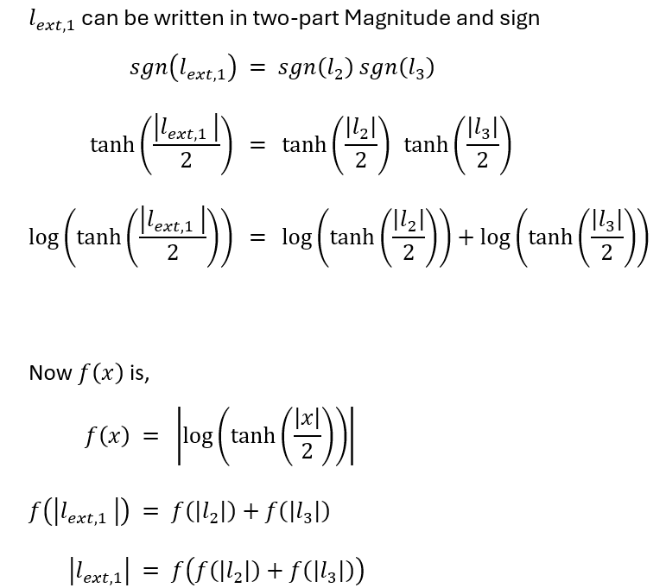
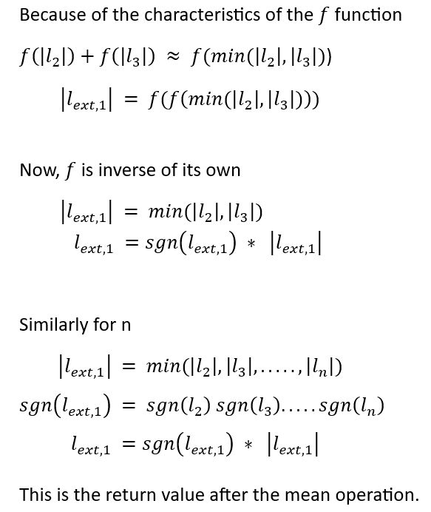
Min-Sum Algorithm

Slide 36
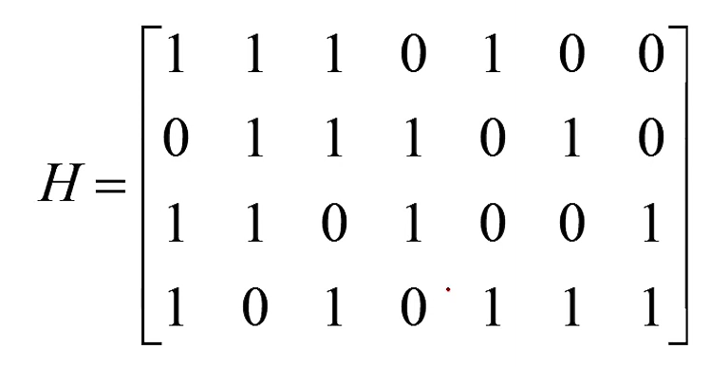
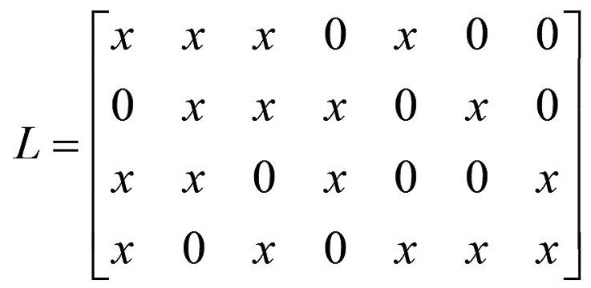
Parity Check Matrix
Storage Matrix
[1]

Slide 37
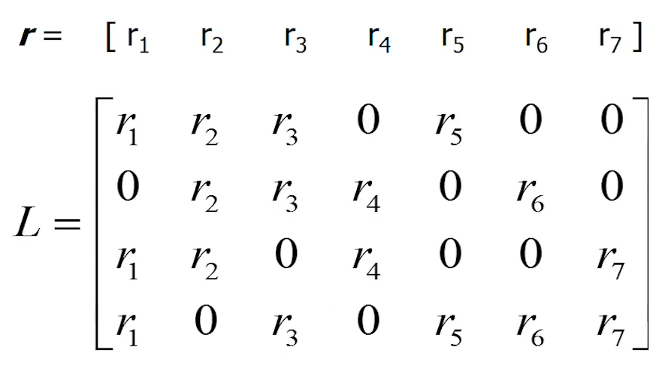
In first iteration every VN sends values to each CN
[1]

Slide 38
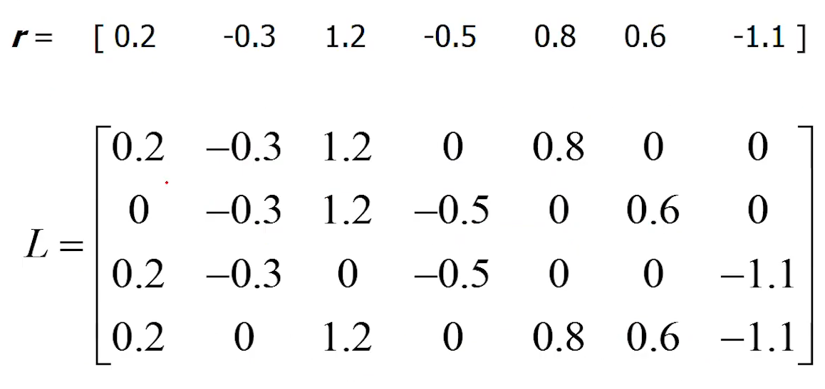


For Example
[1]

Slide 39
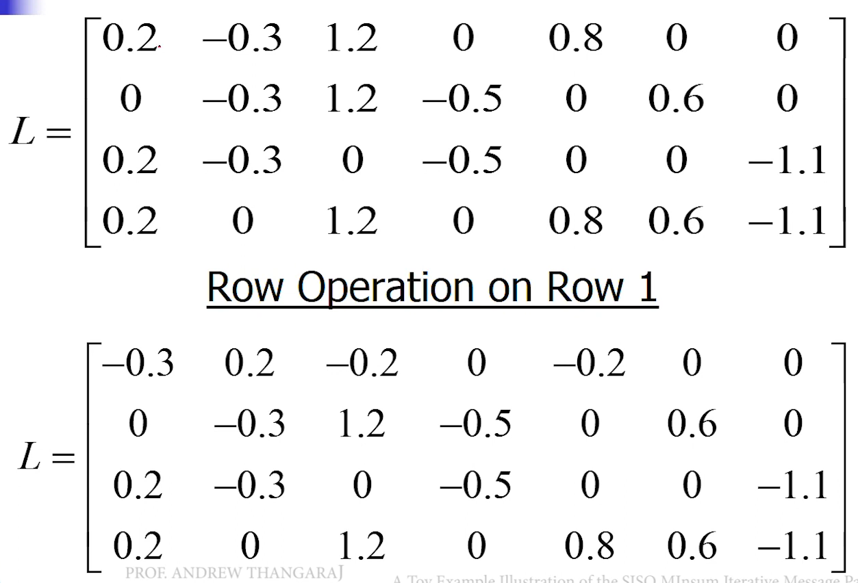
Row Operations are done by Min-Sum Algorithm
Row Operation on Row 1
[1]

Slide 40
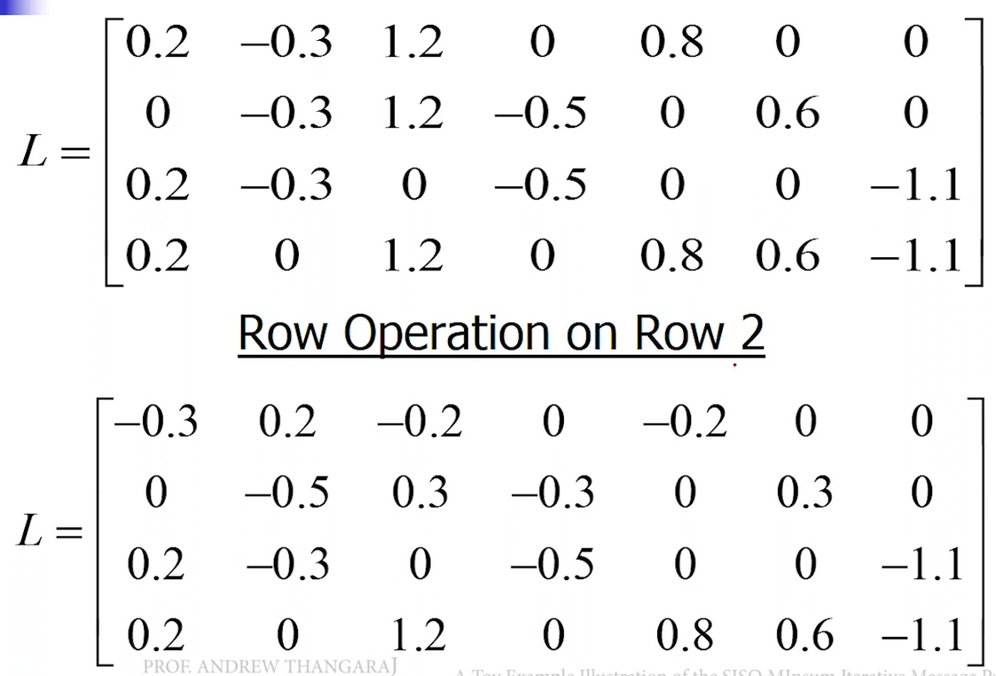
Row Operation on Row 2
[1]

Slide 41
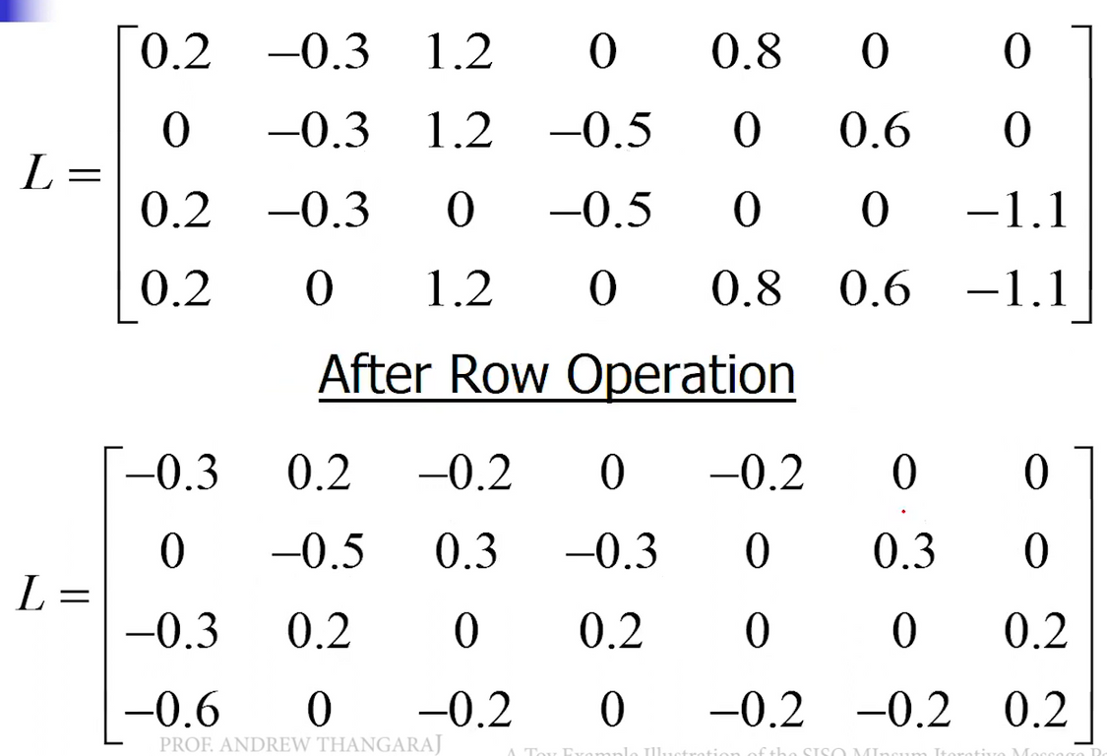
After Row Operations
[1]

Slide 42
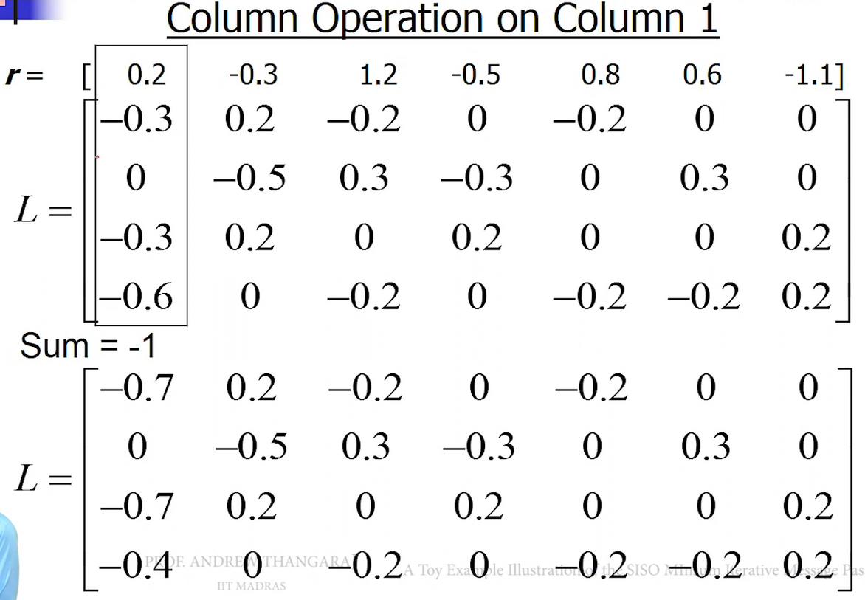
Column Operation on Column 1
[1]

Slide 43
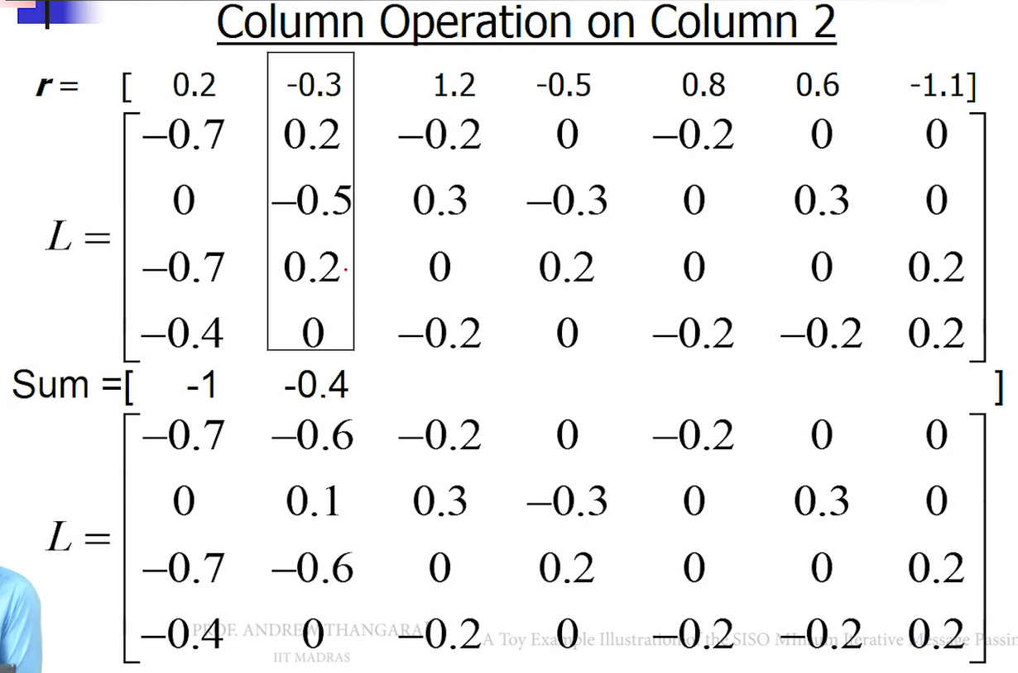
Column Operation on Column 2
[1]

Slide 44
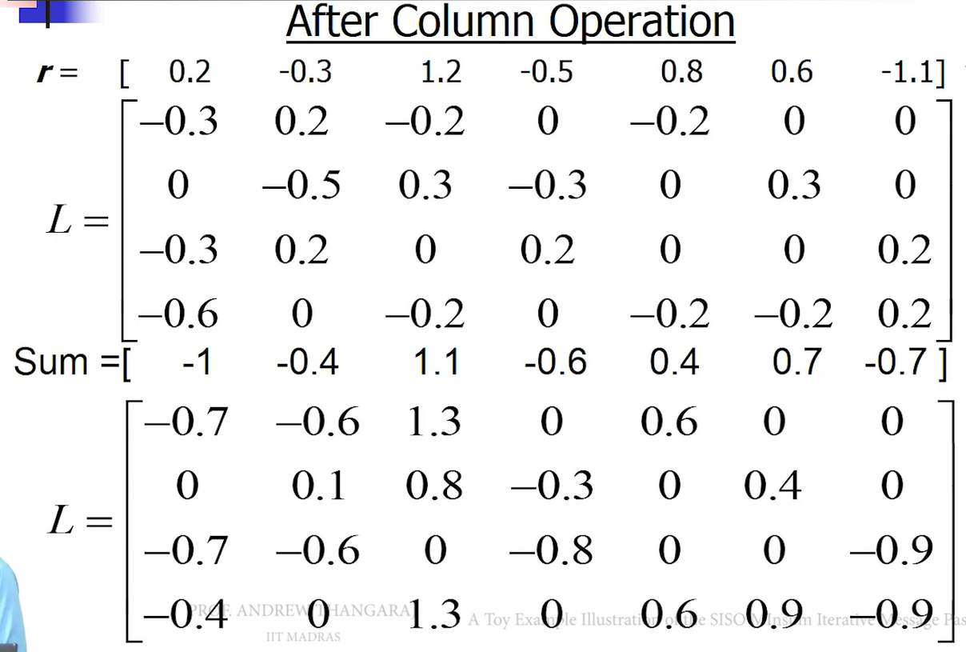
After Column Operations
This is the estimated codeword of previous iteration
[1]

Slide 45
06
Final Results

Slide 46
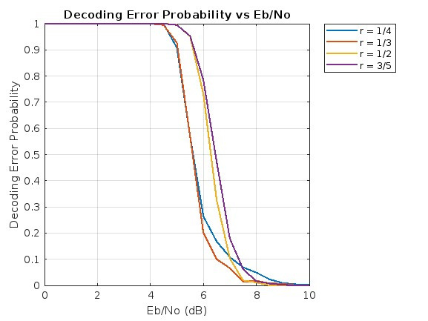
NR_2_6_52
Hard Decision Decoder

Slide 47
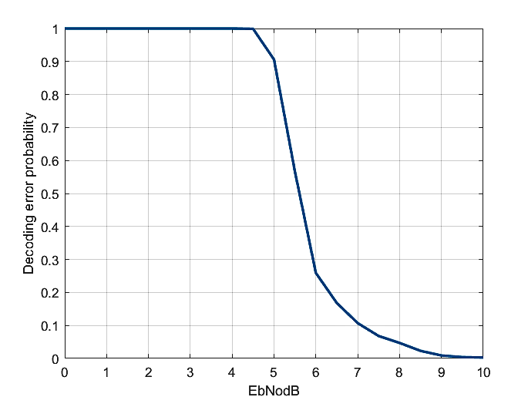
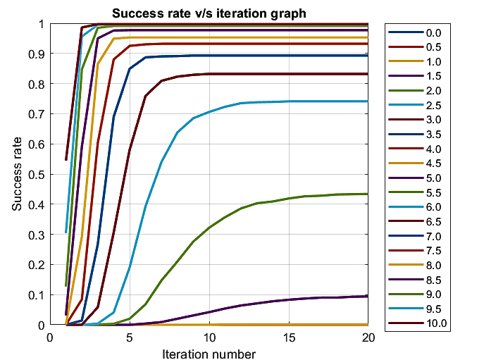
NR_2_6_52
Hard Decision Decoder
For Code-Rate = 1/4

Slide 48
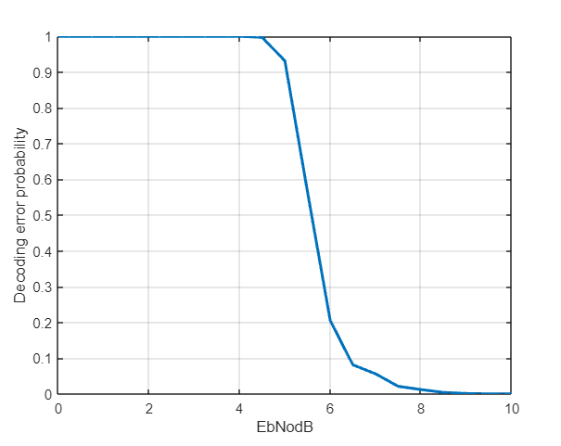
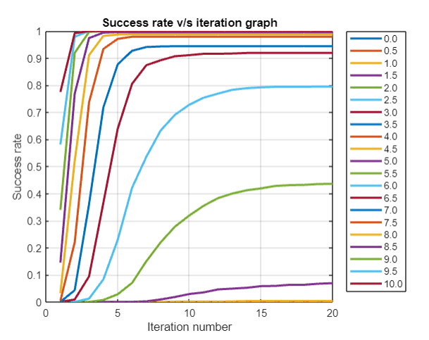
NR_2_6_52
Hard Decision Decoder
For Code-Rate = 1/3

Slide 49
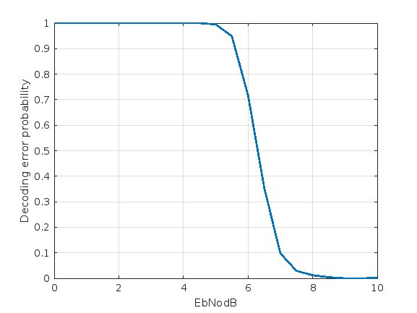
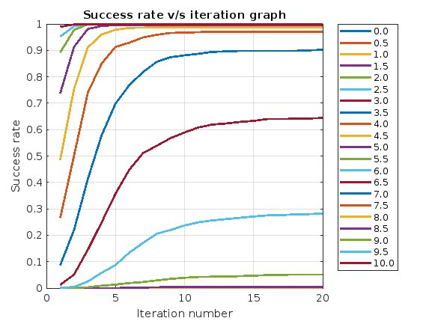
NR_2_6_52
Hard Decision Decoder
For Code-Rate = 1/2

Slide 50
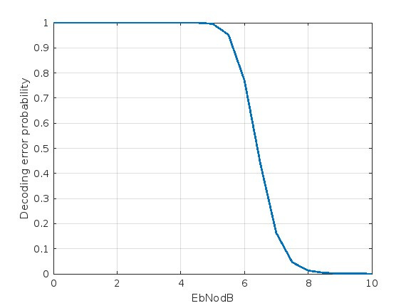
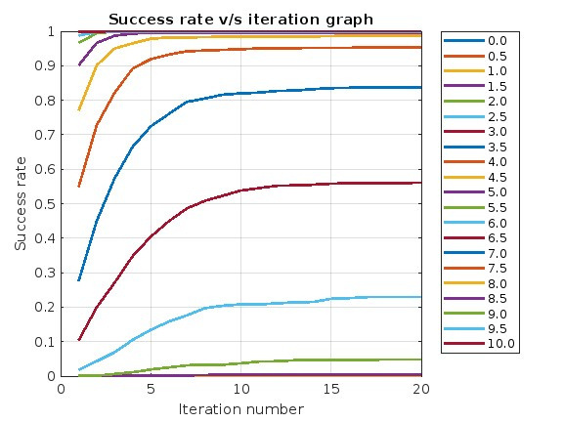
NR_2_6_52
Hard Decision Decoder
For Code-Rate = 3/5

Slide 51
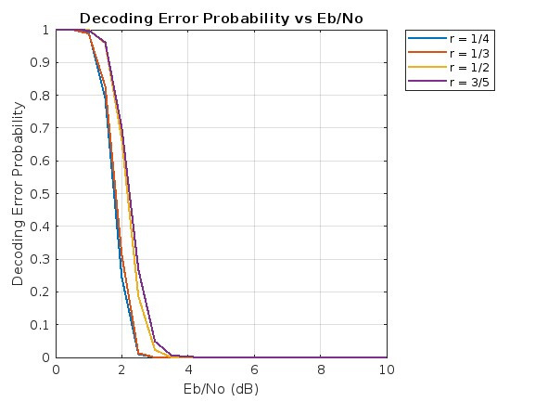
NR_2_6_52
Soft Decision Decoder

Slide 52
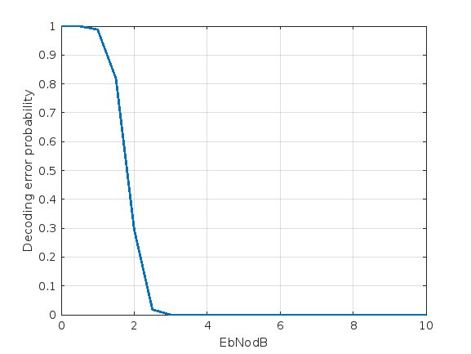
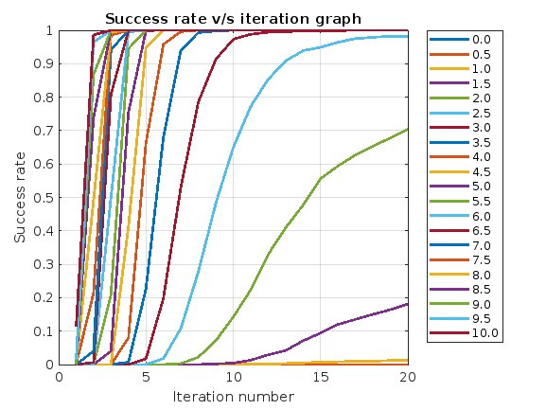
NR_2_6_52
Soft Decision Decoder
For Code-Rate = 1/4

Slide 53
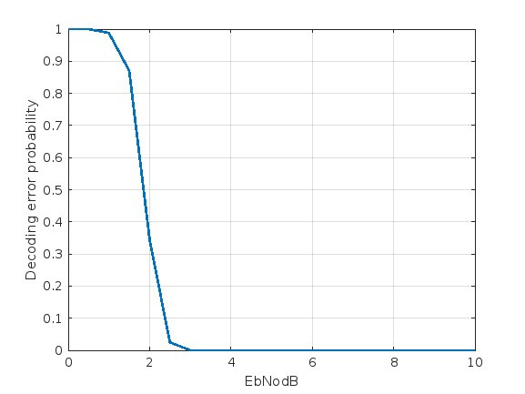
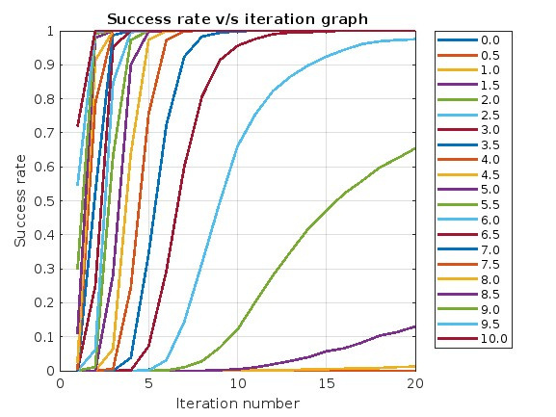
NR_2_6_52
Soft Decision Decoder
For Code-Rate = 1/3

Slide 54
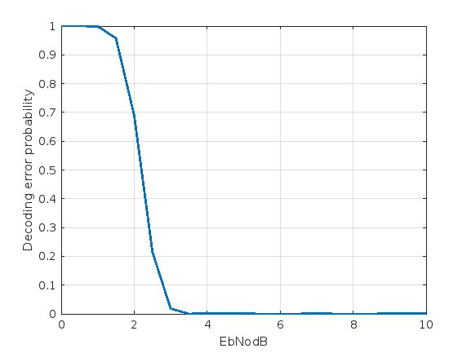
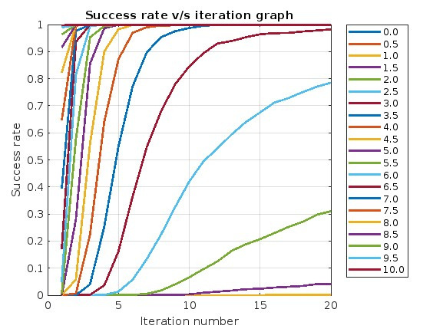
NR_2_6_52
Soft Decision Decoder
For Code-Rate = 1/2

Slide 55
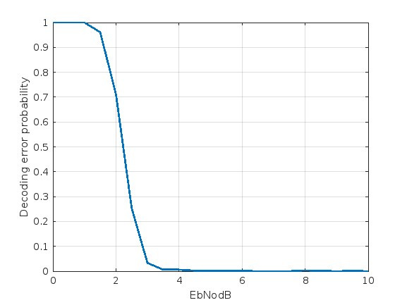
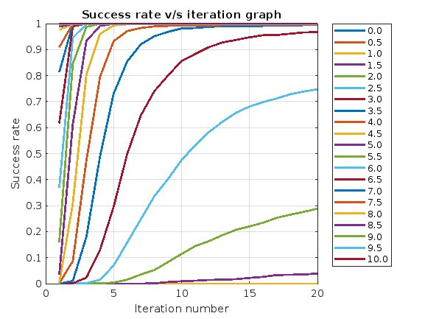
NR_2_6_52
Soft Decision Decoder
For Code-Rate = 3/5

Slide 56
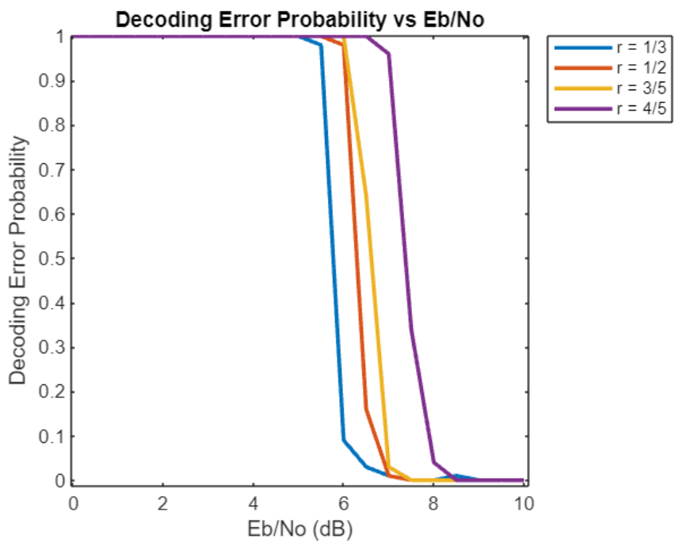
NR_1_5_352
Hard Decision Decoder

Slide 57
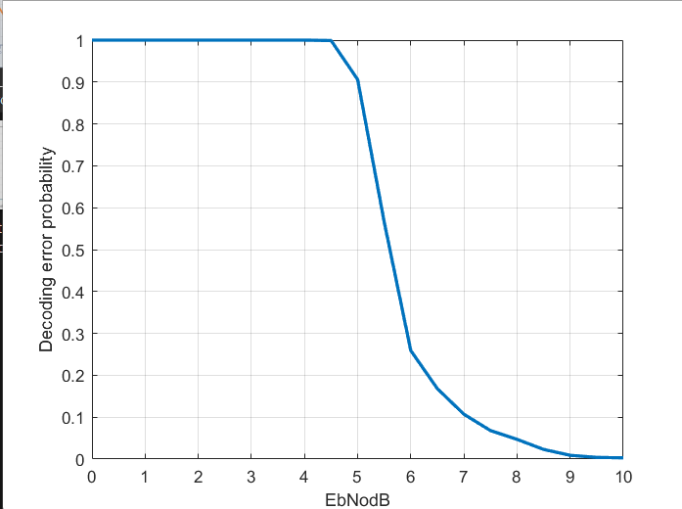
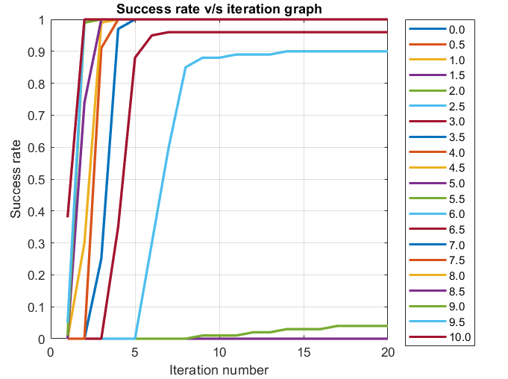
NR_1_5_352
Hard Decision Decoder
For Code-Rate = 1/3

Slide 58
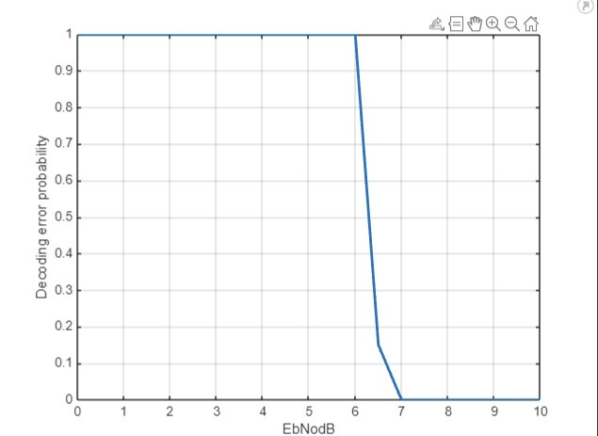
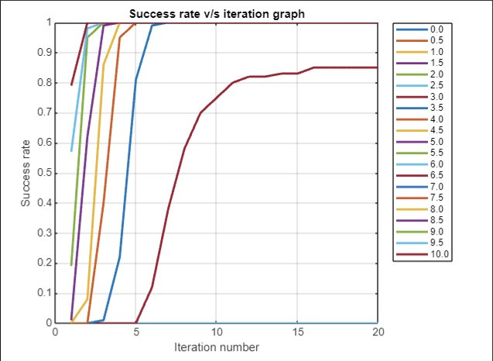
NR_1_5_352
Hard Decision Decoder
For Code-Rate = 1/2

Slide 59
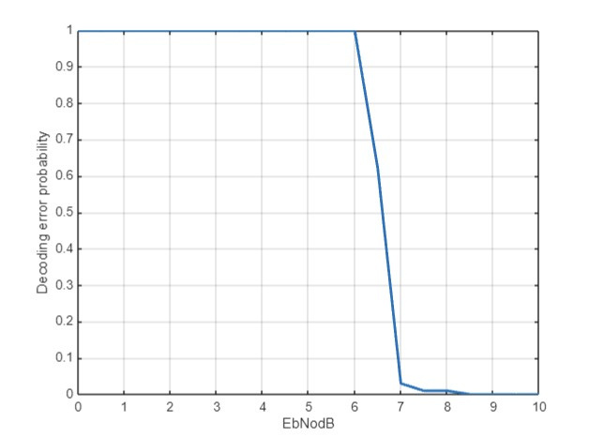
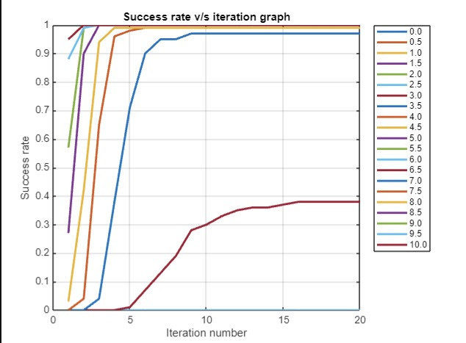
NR_1_5_352
Hard Decision Decoder
For Code-Rate = 3/5

Slide 60


NR_1_5_352
Hard Decision Decoder
For Code-Rate = 4/5

Slide 61

NR_1_5_352
Soft Decision Decoder

Slide 62


NR_1_5_352
Soft Decision Decoder
For Code-Rate = 1/3

Slide 63
NR_1_5_352
Soft Decision Decoder
For Code-Rate = 1/2

Slide 64


NR_1_5_352
Soft Decision Decoder
For Code-Rate = 3/5

Slide 65


NR_1_5_352
Soft Decision Decoder
For Code-Rate = 4/5

Slide 66
Observation
As the signal-to-noise ratio (SNR) increases, the corresponding variance of noise decreases. Consequently, the decoding error probability decreases, leading to an increase in the success rate of each iteration for both decoding schemes.
By looking at how well Hmat1 and Hmat2 perform, we can see that the Soft decision decoder is always performs better than the Hard decision decoder for any code rate and SNR.

Slide 67
Analysis

Slide 68


BER
Hard Decision Decoder

Slide 69


BER
Soft Decision Decoder

Slide 70
Comparison of the simulation with Shannon channel capacity bound
In the above graphs, we observe that the BER vs. Eb/No curve for Soft Decision Decoding achieves the same BER for a lower Eb/No value.
This suggests that Soft decision decoding approaches the theoretical limit set by Shannon's capacity theorem more closely than Hard decision decoding does. This indicates that Soft decision decoding provides better performance in terms of error correction capability.

Slide 71
References
[1] Andrew Thangaraj. Ldpc and polar codes in the 5g
standard, 2019. Accessed on March 24,2024.
[2] Implementation of Low-Density Parity-Check codes for
5G NR shared channels: LIFANG WANG.
[3] CT216. Introduction to Communication Systems: Lecture
3 Channel Coding. DA-IICT, Winter 2024: Prof. Yash
Vasavada.
[4] LDPC Codes - a brief Tutorial: Bernhard M.J. Leiner

Slide 72




Team Members
Rudra Patel - 202201193
Devansh Modi - 202201198
Zeel Boghara - 202201201
Meet Mahaliya - 202201204
Swayam Hingu - 202201207
Mihir Prajapati - 202201210
Kartavya Akabari - 202201213
Jeet Patel - 202201216
Meet Sarvan - 202201218
Chirag Chaudhari - 202201219
Himanshu pandar - 202201222

Slide 73




Thank you!
CREDITS: This presentation template was created by Slidesgo, and includes icons by Flaticon, and infographics & images by Freepik

